Slide 1


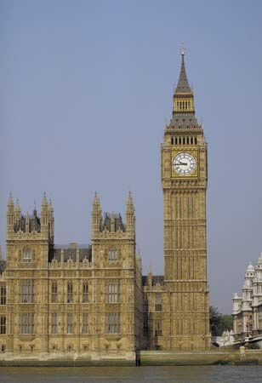
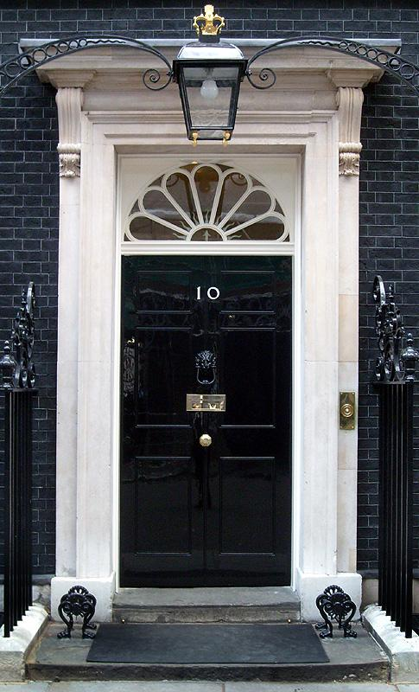
A Level Politics (Edexcel)
Pre-Course Learning

Slide 2

A Level Politics
WHAT DOES THE COURSE AIM TO DO?
It aims to:
Provide you with a ‘balanced education in politics’, and ‘understanding of the nature of politics, and an understanding in the context of the Untied Kingdom, including its local, national and European dimensions, and some aspects of comparative study of other political systems.’
You will be assessed on your ability to organise and present information, ideas and arguments clearly and logically in continuous prose using good quality English
THE SKILLS YOU WILL DEVELOP
· Knowledge and understanding of basic political ideas , concepts, structures and processes, the relationship between them and how they work at different levels.
· An ability to interpret and analyse political information in various forms and from various sources, and to apply a range of political ideas concepts and theories.
· An ability to evaluate arguments, theories, values and ideologies to explain political behaviour and suggest solutions to controversial issues.
· The skills to organise and present an argument with relevance, clarity and coherence using good English.

Slide 3
WHAT DOES THE COURSE INVOLVE?
What will you study?
Term | Topics Covered | Exam
Year 12:
Autumn Term | UK Politics Democracy and participation Political parties Electoral system Voting behaviour and the media | A level: 2 hours to also include Core political ideas.
Spring Term | UK Government The constitution Parliament Prime Minister and executive Relationships between the branches | A Level: 2 hours to also include Non-Core political ideas,
Summer Term | Core political ideas: Conservatism Liberalism Socialism Non-Core political ideas: Nationalism | A level: 2 exam papers 2 hours each to cover UK politics (including Core political ideas) and UK Government (including non-Core political ideas)
Year 13:
Autumn Term | Global Politics: The State and Globalisation Global Governance Human Rights and Environmental Power and Developments Regionalism Liberalism and Realism | A Level: 1 exam paper on Global Politics 2 hours
Spring Term

Slide 4







HOW WILL YOU BE SUCCESSFUL IN THIS COURSE?
YOU WILL NEED TO TAKE AN INTEREST IN CURRENT AFFAIRS AND POLITICAL ISSUES
This will involve:
Reading a QUALITY newspaper (such as The Times, Guardian, Telegraph, Independent or their Sunday equivalent;
magazines and specific politics journals such as Politics Review as well as the set textbooks.
Watching current affairs programmes such as Panorama, Despatches etc. and specific politics programmes such as ' A Week in Politics‘.
Watching the news or listening to 'Today' on Radio 4.
Discussing and debating political issues with both fellow politics students and others
Keeping a scrap book of press cuttings on politics and issues
Interest alone is not enough!
You will have to read widely and work hard to understand:
The institutions and main features of the British system of government and British politics.
How these work in theory and practice
The way they interact their strengths and weaknesses
The way they may change
Continuity is essential: Part-timers are of no use!
You will be given a variety of tasks:
Reading
Research
Short answers
Stimulus response questions
Essays.
To ensure quick feedback and a planned workload it is essential that all work is completed by set deadlines.

Slide 5
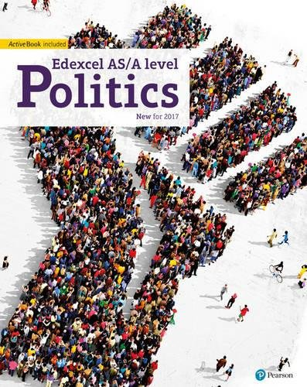
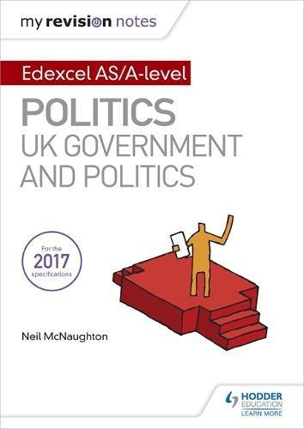
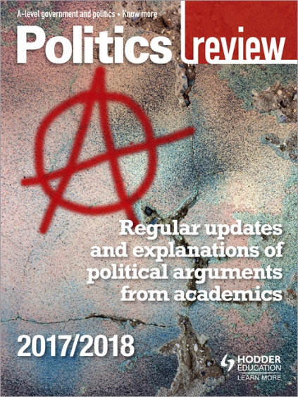
WHAT RESOURCES ARE AVAILABLE TO HELP WITH MY A LEVEL STUDIES?
I recommend that you purchase the following books before your return to school in September.
Set Texts:
Edexcel GCE Politics AS and A-Level Student Book (Edexcel GCE Politics 2017)
by Goodlad, Mitchell, Colclough, Levinson, Laycock, Schindler & Tomes
ISBN: 978-1292187020
This book is not published until 28th July 2017
My Revision Notes: Edexcel AS/A-level Politics: UK Government and Politics
By Neil McNaughton
ISBN: 978-1471889660
This book is not published until 26th January 2018
You could also purchase an annual subscription to the Politics Review.
https://www.hoddereducation.co.uk/Product/9781471890598.aspx

Slide 6
InductionTasks
TASK 1: complete the following activities. You will need to start with the booklet ‘Parliament Find Your Way’.
Find Your Way (gov.wales)
Read the relevant pages in this booklet and then complete the following tasks.
1. The History of Parliament
Watch the following video and use the pages of Find Your Way
Visit (23) Houses of History - Explore the story of Parliament and democracy - YouTube
Create a timeline to illustrate the ‘Journey to Democracy’.
2. Democracy
Read page 6-7 in the booklet.
Write a definition for the following words:
  Democracy
  Representative democracy
  Direct Democracy
  Politics
  Dictatorship
  Suffrage
  Franchise
Watch ‘Democracy? You Decide’:
(23) Democracy You decide with Danny Wallace, part 1 of 2 - YouTube
(23) Democracy You decide with Danny Wallace, part 2 of 2 - YouTube
Answer the following question:
  What would the UK be like if we didn’t live in a democracy?
  What are the strengths and weaknesses of the UK system of democracy?
  What other options are there and where are they in place right now?
3. The Constitution
Read page 8-9 in the booklet.
Write a definition of the following words:
  Constitution
  Uncodified constitution
  Codified constitution
  Parliamentary sovereignty
  Devolution
  The Human Rights Act
  The European Union
  The UK Supreme Court

Slide 7
4. The constitution: The EU
Read page 10-11 in the booklet.
Visit http://Europa.eu
Use your research to answer the following question:
  In what areas can the EU make laws that the UK has to follow?
  What happened if there is conflict between EU law and UK law?
  Provide an example of where EU and UK law has conflicted – what was the outcome?
Make a list of the pros and cons of the UK being a member of the EU.
Study the results of the EU referendum on the 23rd June – what was the outcome? Why do you think this side won?
5. Parliament
Read page 12-17 in the booklet.
Write a definition of the following words:
  Bicameral legislature
  House of Commons
  House of Lords
  Monarch
  Legislation
  Scrutiny
  Representation
  Two-House system
  Bills
  The Queen’s Speech
  Select Committees
  General Committees
  Public Bills Committee
  Grand Committees
  Liaison Committee
  Prime Minister's Questions
  Ministerial Questions
What role does the monarch have in our Parliament?
What is the benefit of a two-House system?
What is the key role of the committees?
What is the main different between the House of Commons and the House of Lords?
Who do MPs represent?
Constituents
MPs
Government Minister
Backbencher
The Executive
Government
Opposition
Cabinet
Speaker
The Legislature
Crossbenchers
Lord Speaker
House of Lords Act 1999
Hereditary Peers
Life Peers
Peers Spiritual

Slide 8
5. Parliament cont’d
What is the difference between the Executive and the Legislature?
How in the UK system of government do these over-lap? (Clue: this is called Fusion of Power)
What is the major problem with the House of Lords in terms of democracy?
What are the pros and cons of having an unelected second chamber?
Who would you nominate as a Life Peer and why?
High Court Judges also used to sit in the House of Lords: where do they now sit? Why do you think it was important to separate them from the work of the House of Lords?
6. Legislation: Making New Laws
Read page 12-17 in the booklet.
Write a definition of the following words:
  Public Bills
  Government Bills
  Private Members Bills
  Manifesto
  Amendments
  Division
  Filibuster
  Free Vote
  Green Paper
  Motion
  Ping-Pong
  Tellers
  Wash-up
  White Paper
Watch the following video
How are laws made? - UK Parliament
  What one law would you make and why?
  How would you enforce the law?
  What implications might it have for communities in the UK?

Slide 9
7. Elections and Voting
Read page 20-21 in the booklet.
Write a definition for the following words:
  General election
  Devolved Assembly/ Parliament elections
  European elections
  Local elections
  By-elections
  Referendums
Read through the different types of voting systems on page 21. Which do you think would be the best system for the UK to adopt for General Elections and why?
In 2011 there was a referendum on introducing AV. Research the outcome of this referendum. Why do you think this outcome occurred?
8. Elections and Voting: Trends and Types
Read page 22-23 in the booklet.
Write a definition for the following words:
  Voter Turnout
  Polling Day
  Compulsory Voting
  Separation of Powers
  Proportional Representation
Why do you think voter turnout is low in Britain?
Should the UK make voting compulsory? What are the arguments for and against?
Should the voting age be lowered to 16? What are the arguments for and against?
You will soon be old enough to vote – how do you register to vote?
Go to Referendums held in the UK - UK Parliament and research another referendum that has happened in the UK. (Do not select the AV Vote or the EU referendum)
What was the topic of the referendum? What was the turnout? What was the
outcome?

Slide 10
9. Political Parties
Read page 24-25 in the booklet.
Write a definition for the following words/topics:
  Political Party
  Coalition government
  Majority
  Functions of political parties
  Party Whips
  Party Rebels
  ‘withdrawing the whip’
Which political party currently governs this country?
How many seats (or MPs) do the three main parties each have in the House of Commons?
Research the main political position of the three main political parties in the following areas:
  Immigration
  Taxes and the Economy
  The NHS
  Security, defence and foreign affairs
  Jobs
  Education
  Law and Order
  Benefits/ Poverty
Who would you vote for and why>
10. Pressure Groups
Read page 26-27 in the booklet.
Write a definition for the following words/topics:
  Pressure Group
  Lobbying
  Petitions
  Popular protest
  Celebrity endorsement
  Direct Action.
How is a pressure group different from a political party?
Research one pressure group – why is its aim? Who does it represent? What methods has it used to try to get its message across? How successful has it been?

Slide 11
Current Affairs Diary
TASK 2: in addition to these research projects you must also start your current affairs diary in the summer holidays. You will continue to keep this diary throughout your time studying politics in the sixth form.
How to keep a current affairs diary:
Each morning you must listen to, watch or read what is going on in the country and make a list of the top three news stories. You can do this whilst you are getting ready in the morning; whilst travelling into school on weekdays; by looking at one of the internet news sites and/or spending some time each day in the school library or at home looking at a newspaper.
In your diary make a list of the top three stories, including a brief outline of what has happened.
At the end of each week you must select one of these stories and write a short editorial on it. This should include:
  An objective explanation of the issue. How it has progressed across the week.
  Opinions from different viewpoints.
  Your opinion – including where applicable alternative solutions to the problem or issue being criticised.
You should purchase a notebook to record your diary in. It is important that this is kept up to date and that you bring it to all lessons. It will be collected in at random to check that you are up-to-date. The quality and quantity of work in this diary will form part of your termly skills check and effort scores will be awarded accordingly.
On your return to school in September please bring with you:
Copies of any purchased text books.
Your up-to-date current affairs diary
Your lever-arch folder set up with dividers to cover all the units you will be studying.
You must provide evidence that you have completed all the research tasks. Do not just copy and paste from the internet, particularly with word definitions – make sure that you really understand everything you write. This may mean that you need to do further research to develop your understanding.
There will be a knowledge and understanding test on your return.

Slide 12
Wider Reading and Research
1.Read quality newspapers
This means read newspapers from across the political spectrum, not just ones that align with your political views. Quality newspapers are defined as; The Times, The Telegraph, The Financial Times, The Guardian, and the Independent. Reading a cross section of these will allow you gain a broad insight into the views of both left and right commentators
2.Bring the News to you
Take the work out of finding the political stories and let them come directly to you. Most newspapers have email updates that you can sign up to. I have included a selection of them here, but I can personally recommend the Times RedBox and CoffeeHouse from the Spectator.
The Times RedBox
The Telegraph Morning Briefing
Spectator Lunchtime Espresso
Spectator CoffeeHouse
Guardian Today UK
3.Use Twitter Extensively
https://twitter.com/bbcpolitics?lang=en
https://twitter.com/hashtag/ukpolitics?lang=en
4.Watch Political Programming
UK Television is filled with programmes all brimming with politics, so take your pick and find the programmes you love most. My favourite would be the Daily Politics and Question Time. I have included a brief list of suggested programmes for you to watch
The Daily Politics (BBC Monday-Friday Lunchtime)
The Sunday Politics (BBC Sunday Morning)
Andrew Marr Show (BBC Sunday Morning)
Question Time (BBC Thursday Evening)
This Week (BBC after Question Time)
Sky News
Peston on Sunday (ITV, Sunday Morning)

Slide 13
Recommended Reading
Classic Texts
Democracy in America, Alexis de Tocqueville, Penguin, ISBN: 0140447601
Leviathan, Thomas Hobbes, Oxford, ISBN: 0192834983
**On Liberty, John Stuart Mill, Oxford, ISBN: 0192833847
Second Treatise of Government, John Locke, Hackett, ISBN: 0915144867
Utilitarianism, John Stuart Mill, Oxford, ISBN: 019875163X
The Communist Manifesto, Karl Marx, Oxford, ISBN: 0192834371
The English Constitution, Walter Bagehot, Oxford, ISBN: 0192839756
The Federalist Papers, James Madison et al, Penguin, ISBN: 0140444955
The Prince, Niccolo Machiavelli, Oxford, ISBN: 019280426X
The Republic, Plato, Penguin, ISBN: 0140449140
The Rights of Man, Thomas Paine, Oxford, ISBN: 0192835572
**The Social Contract, John-Jacques Rousseau, Penguin, ISBN: 0140442014
More recent attempts to explain Politics
After Blair: David Cameron and the Conservative Tradition, Kieron O’Hara, Icon, ISBN: 1840467959
In Defence of Politics, Bernard Crick, Continuum, ISBN: 0826487513
Presidential Power, Richard Neustadt, The Free Press, ISBN: 0029227968
What’s Left?: How Liberals Lost Their Way, Nick Cohen, Fourth Estate, ISBN: 0007229690
Who Runs This Place?: The Anatomy of Britain in the 21st Century, Anthony Sampson, John Murray, ISBN: 0719565669
Why Politics Matters: Making Politics Work, Gerry Stoker, Palgrave, ISBN: 1403997403
The End of History, Francis Fukuyama, Harper, ISBN: 0380720027
The Right Nation: Why America is Different, John Micklethwait, Penguin, ISBN: 0141015365
The Ideas that Conquered the World, Michael Mandelbaum, Publicaffairs Ltd, ISBN: 1586482068
How Democratic is the American Constitution?, Robert Dahl, Yale, ISBN: 0300095244
Readable biographies
Dreams from My Father: A Story of Race and Inheritance, Barack Obama, Three Rivers, ISBN: 1400082773
Gladstone, Roy Jenkins, Pan, ISBN: 0330411713
Harold Wilson, Ben Pimlott, Harper Collins, ISBN: 0006379559
The Natural: The Misunderstood Presidency of Bill Clinton, Joe Klein, Broadway, ISBN: 0767914120
Tony Blair: Prime Minister, John Rentoul, ISBN: 0751530824
William Pitt the Younger: A Biography, William Hague, Harper, ISBN: 0007147201

